Slide 1


Pokémon : Gen 1 gotta graph em all
Ian Arch, Paige Breyfogle, Daniel Buescher, Andrew Stepanek
Ya know.. Instead of catch em all… oof tough crowd

Slide 2

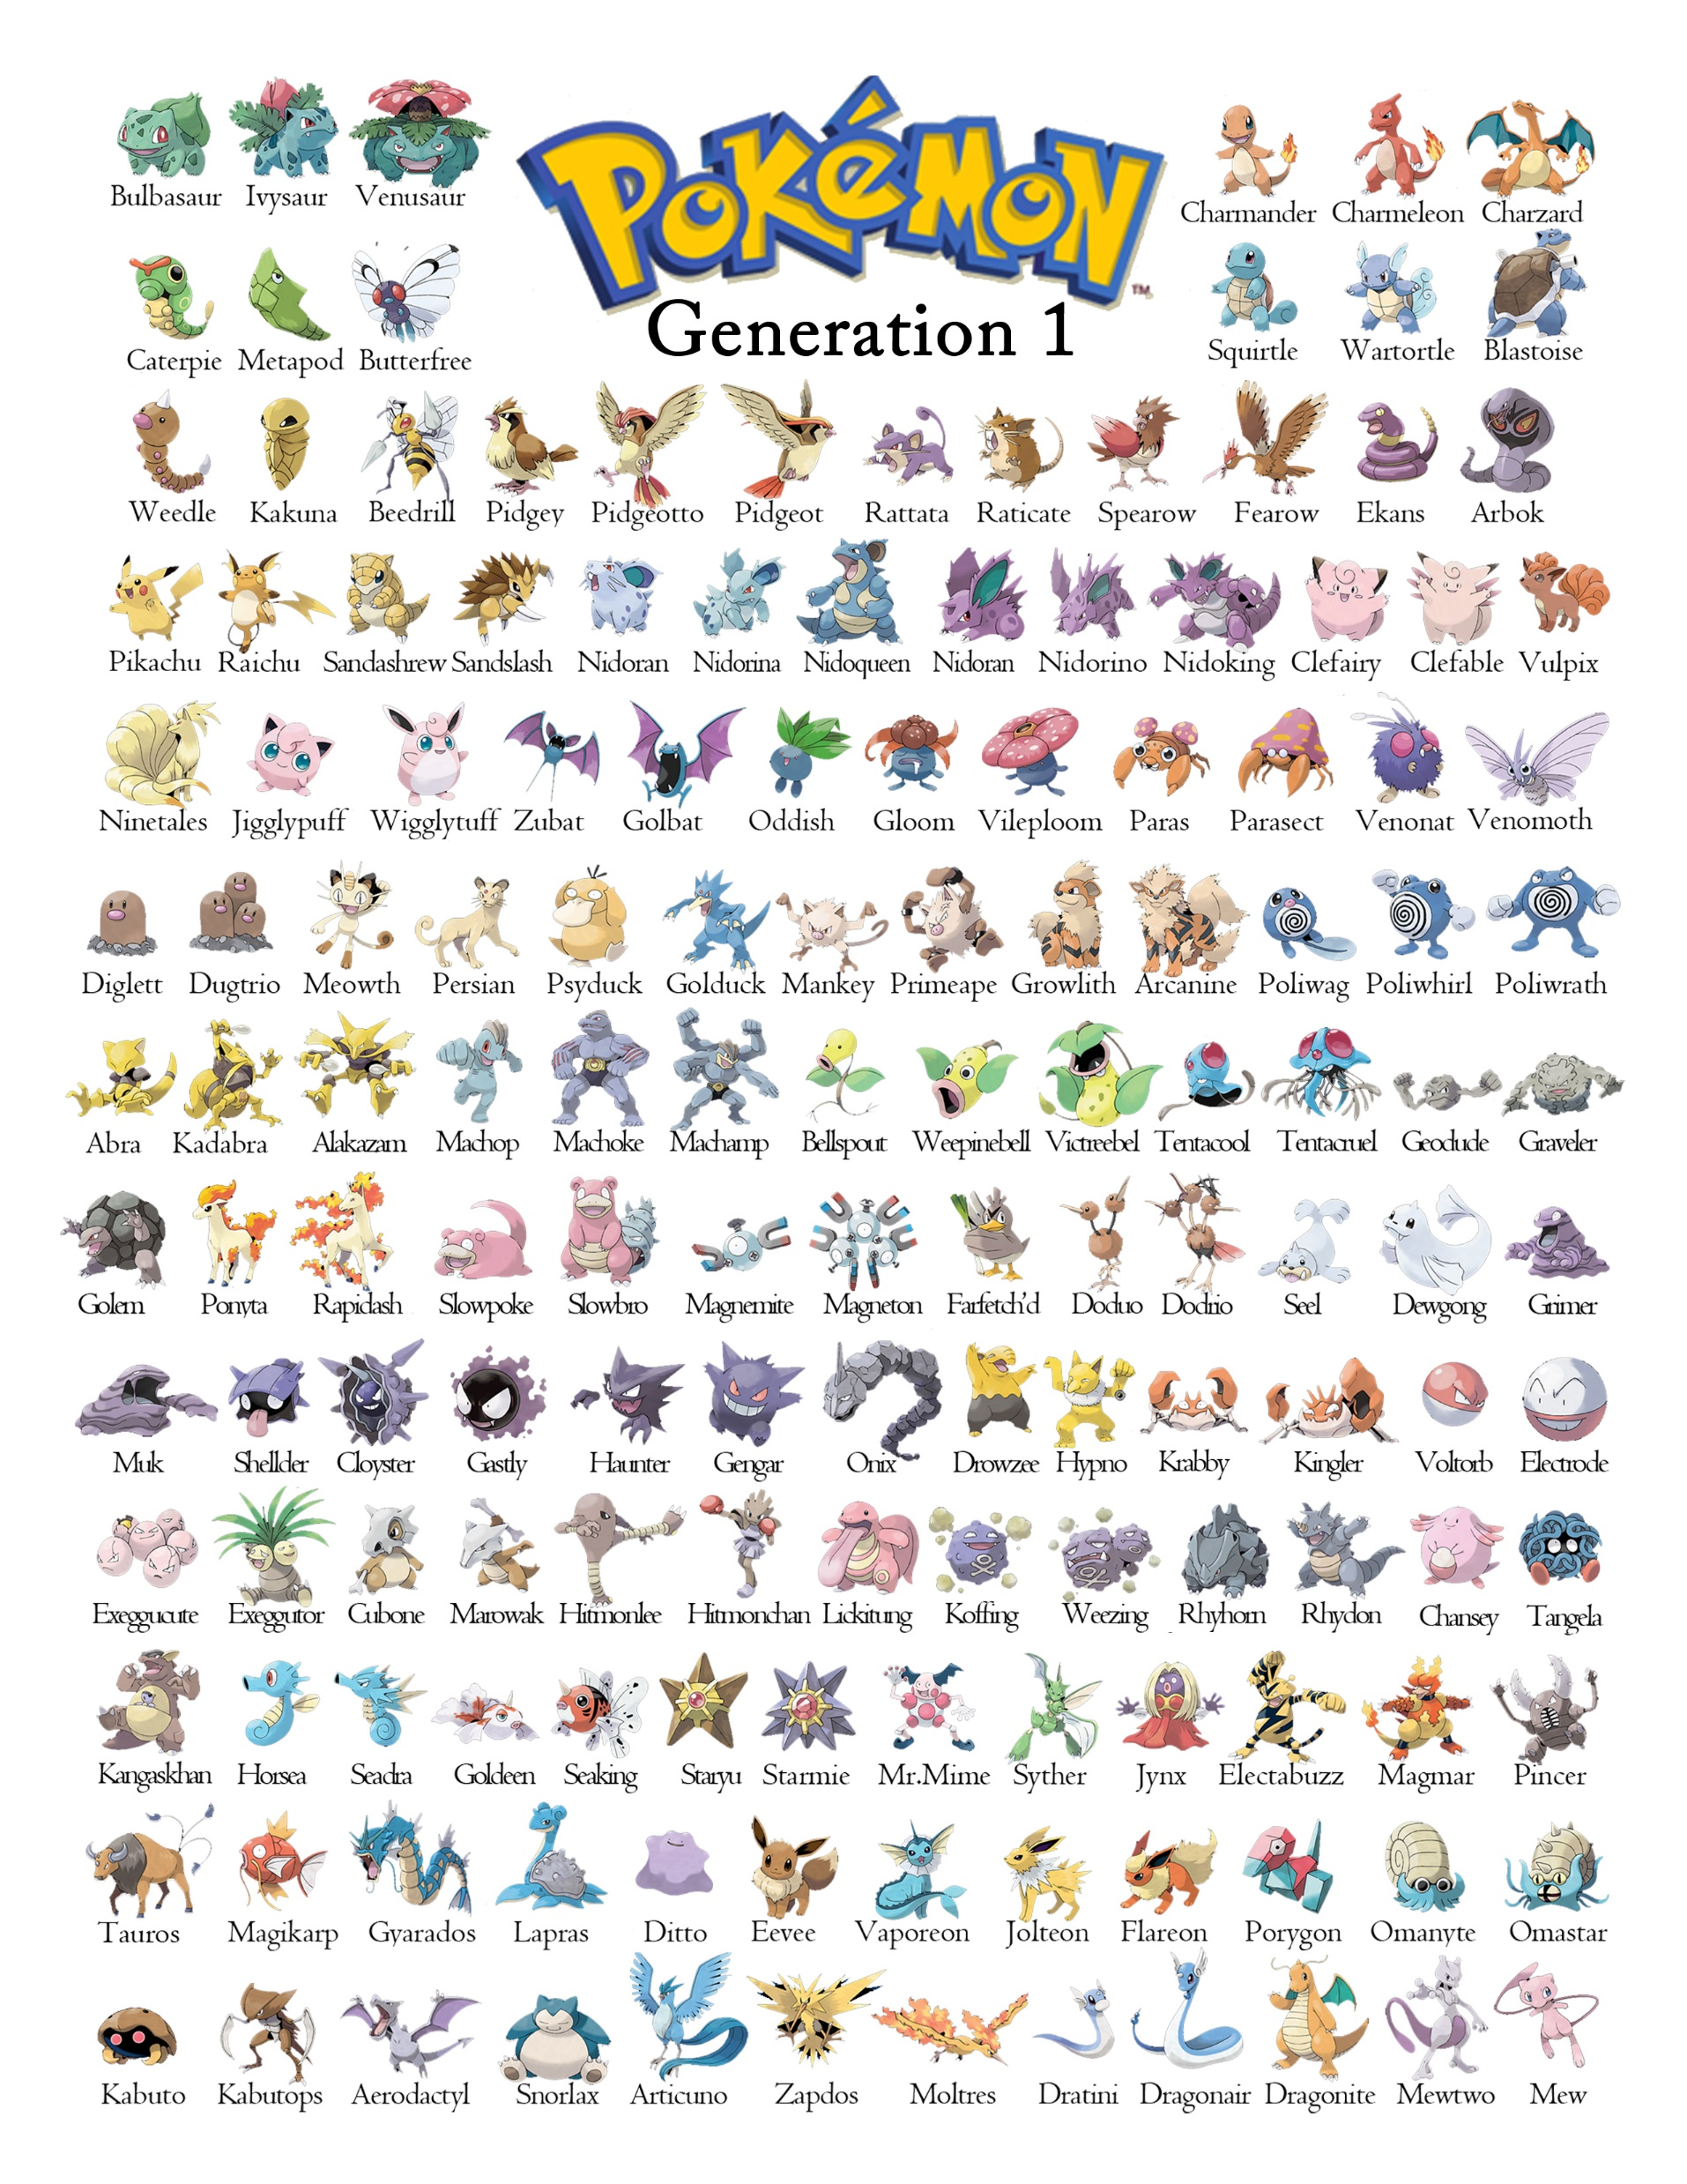

Theme
The topic that we have chosen is Pokemon, the reason we have chose this topic is the nostalgia factor because of Pokémon's prominence in our childhood, as well as educating the current youth on the Original (OG) Gen 1 Pokémon.

Slide 3
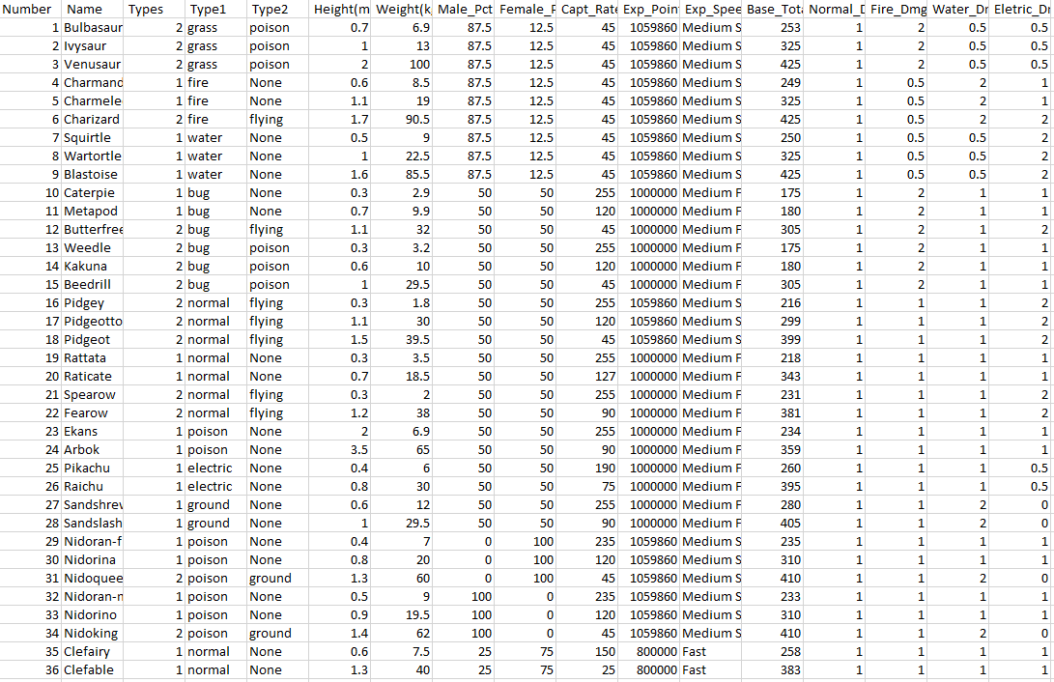
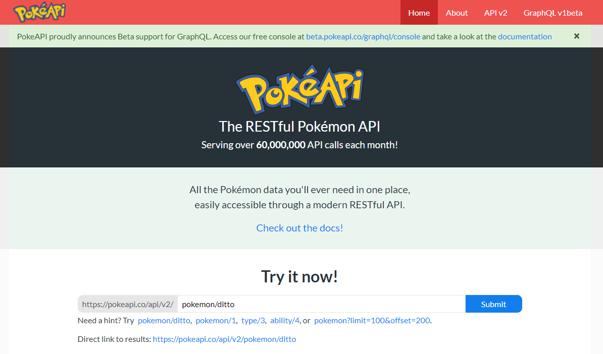
Coding approach Step 1
Pulled in Gen 1 list from Kaggle dataset
Dataset was not sufficient, and untrustworthy
Located an API to communicate with - https://pokeapi.co/

Slide 4
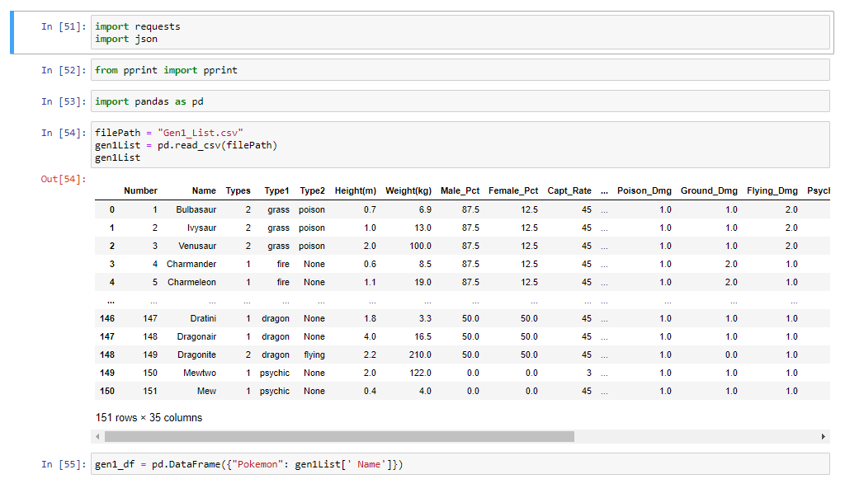
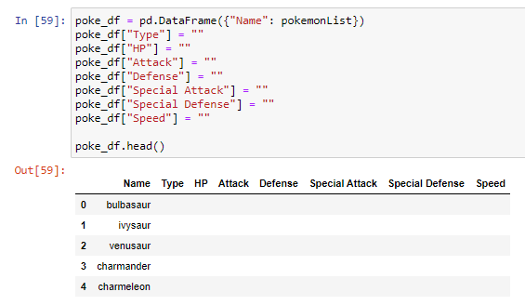
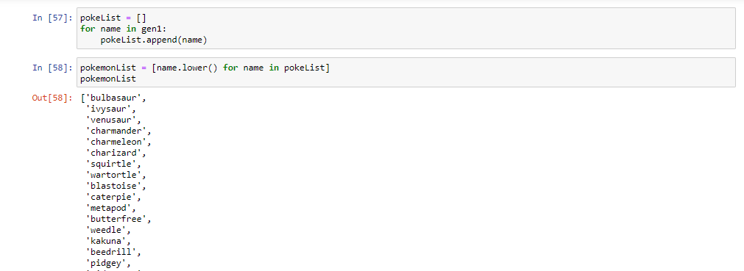
Coding approach Step 2
Used Jupyter to read csv into pandas
Pulled the list of Pokémon
Created data frame with their name and empty table of stats

Slide 5
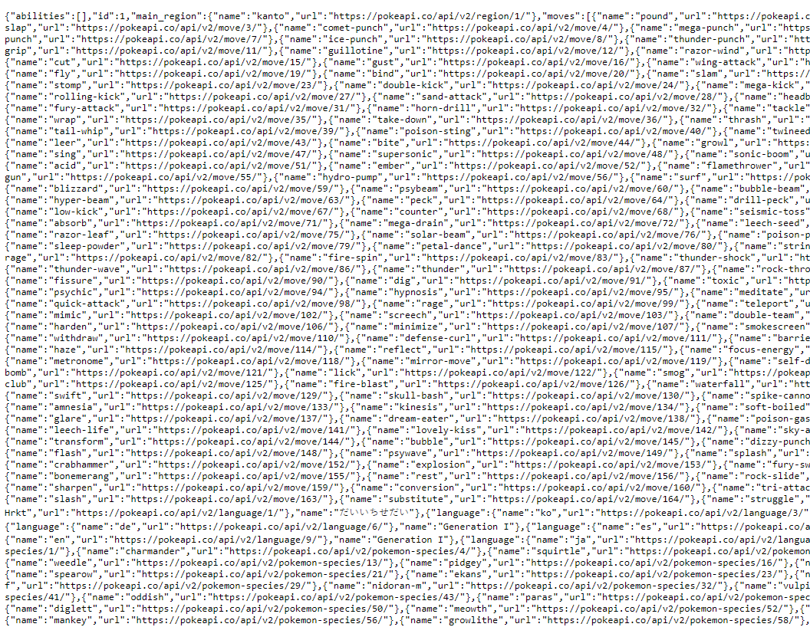
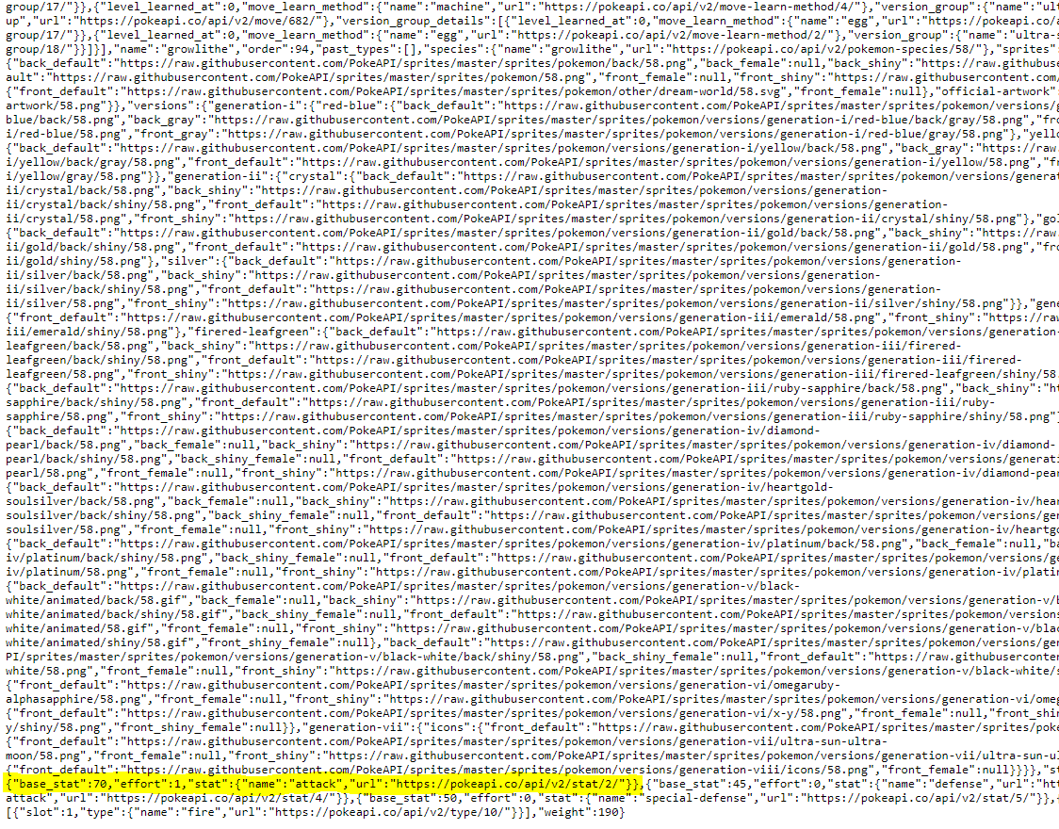
Coding approach Step 3.1
Called to https://pokeapi.co/api/v2/generation/1 to pull data in
Did not receive expected results – URLs

Slide 6
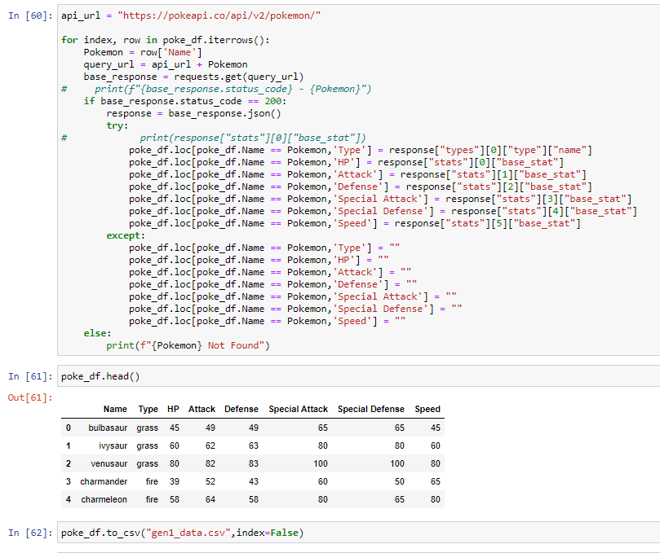
Coding approach Step 3.2
We used a for- loop to call out to each URL to retrieve stats to fill our empty dataframe
Exported data frame to CSV

Slide 7
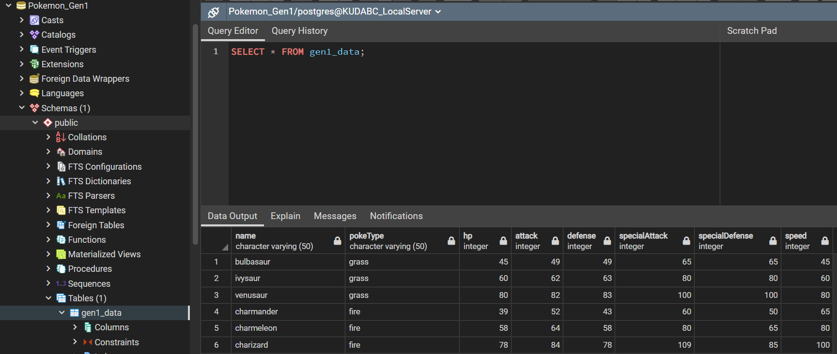
Coding approach Step 4
Created SQL database using PGAdmin
Created table
Imported data frame CSV into table

Slide 8
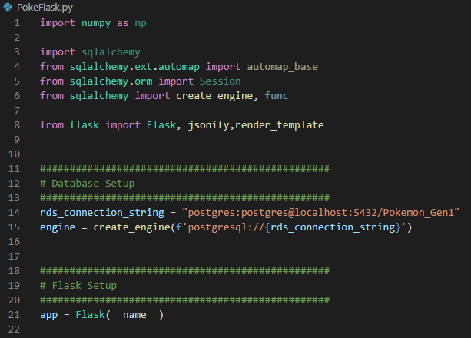
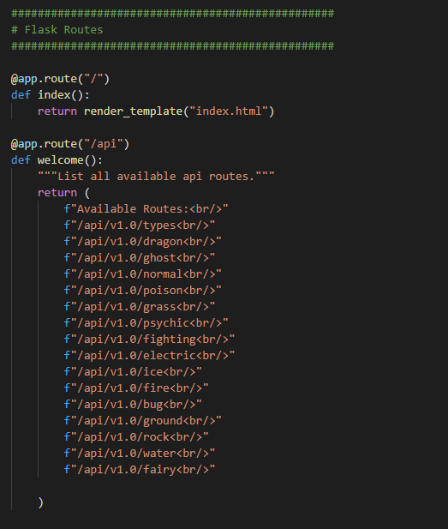
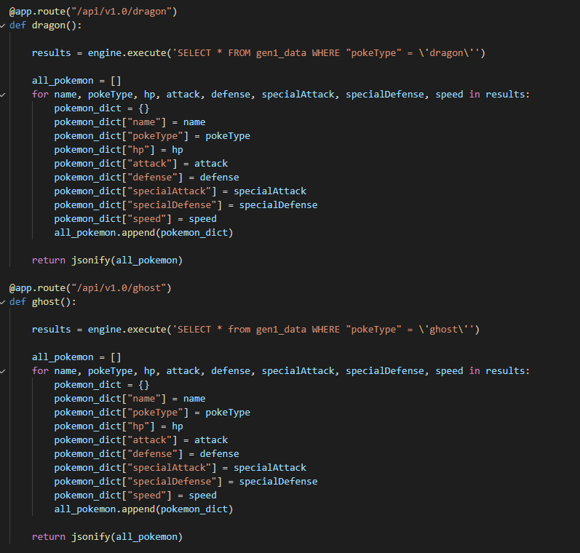
Coding approach Step 5
Created python flask-powered API to communicate with our SQL database
Created routes for each “Type” (Dragon, Fire, Water, etc.)
Each route brought in all the Pokémon for that type, as well as their stats

Slide 9
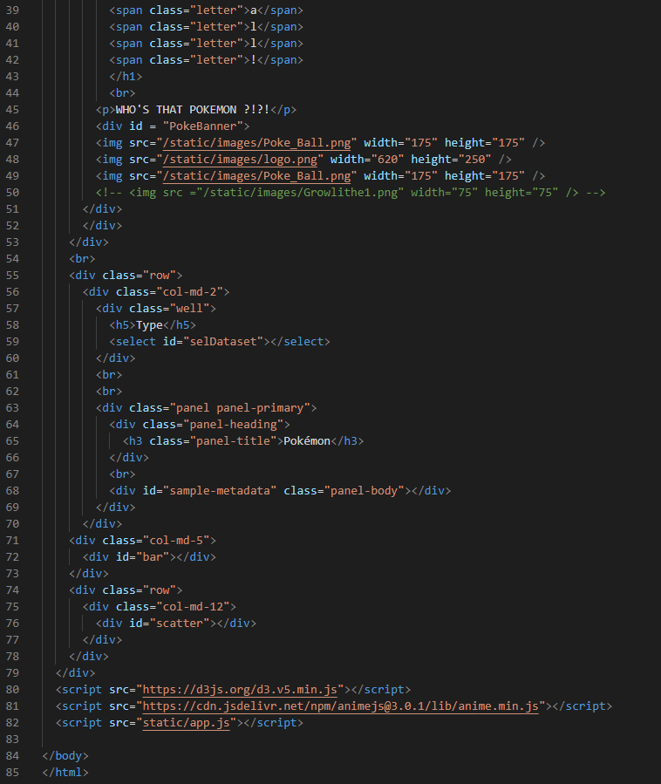
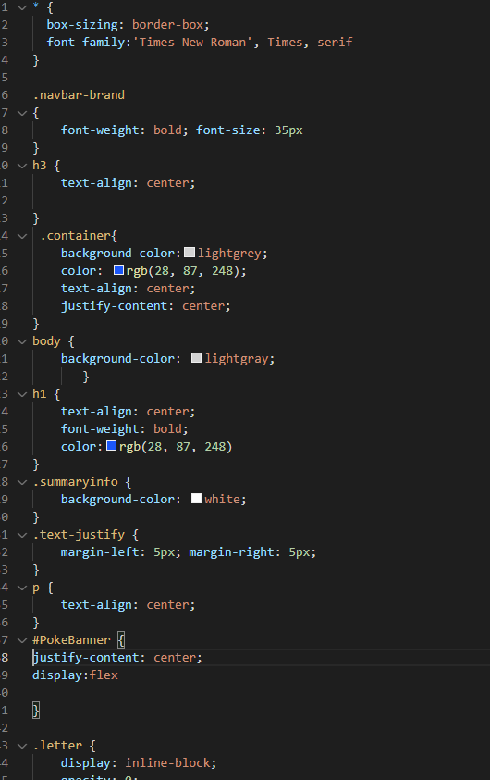
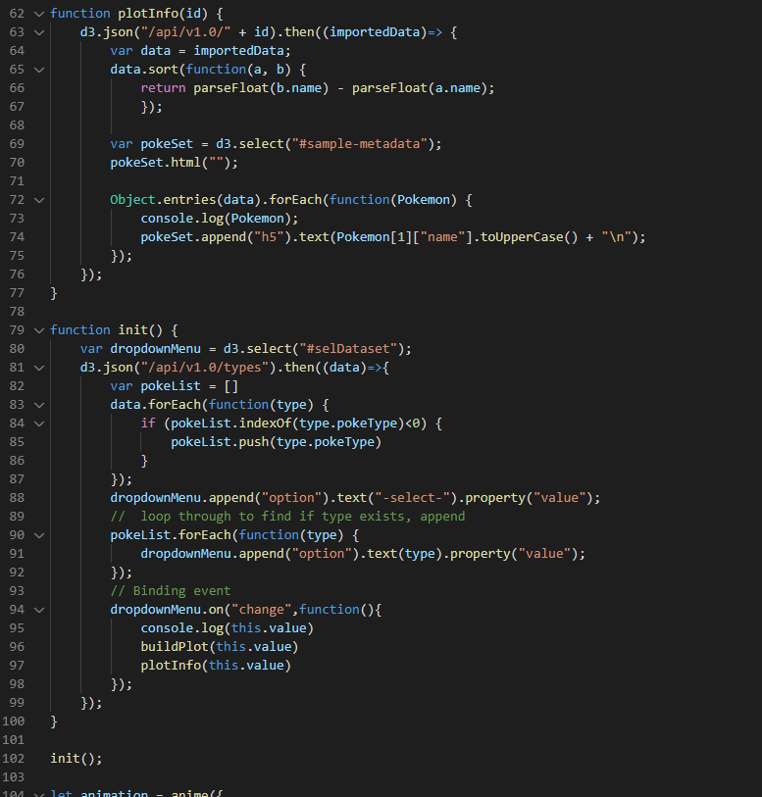
Coding approach Step 6
Used HTML to lay out page
Used CSS to style
Used JavaScript, D3, and Plotly to visualize the data

Slide 10
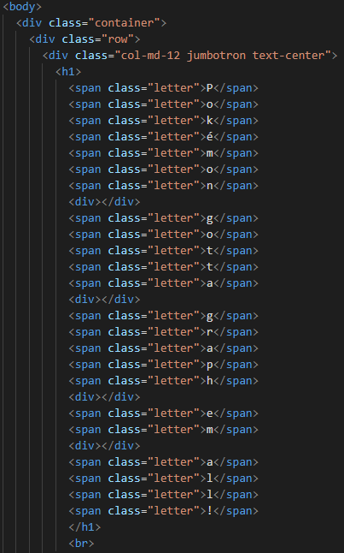
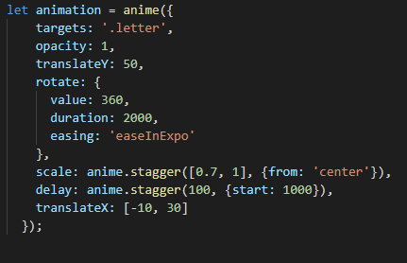
Coding approach Step 7
We used a JavaScript library not covered in class: Anime.js
This allowed us to create an animation of the title upon loading of the page
*Will be shown momentarily

Slide 11

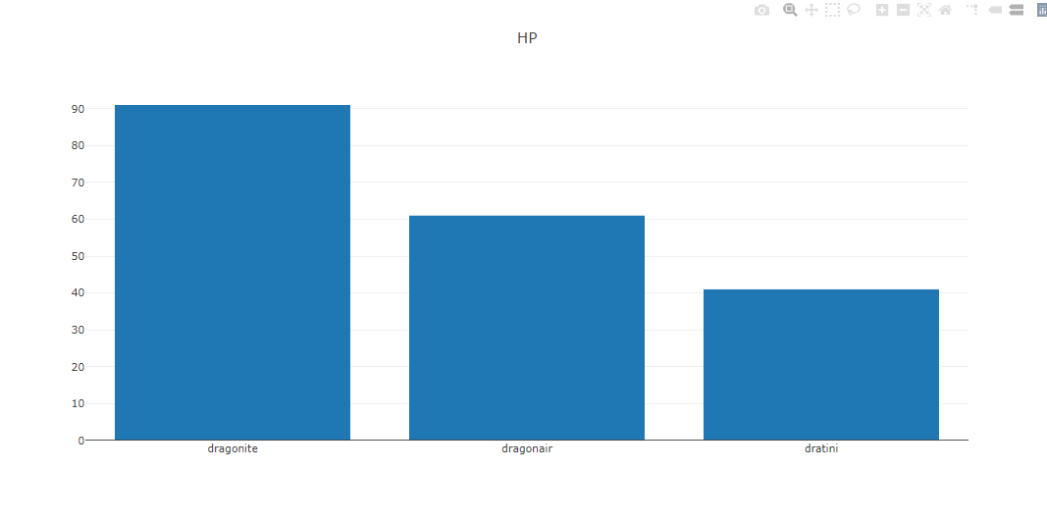
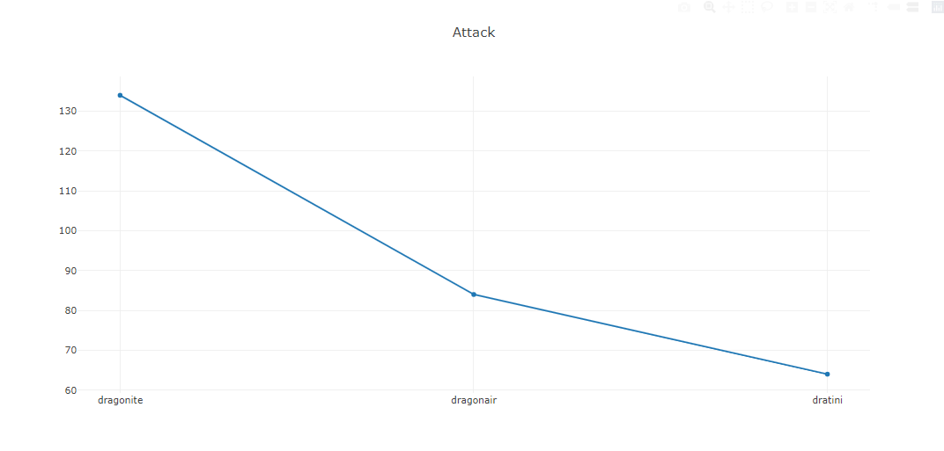
Final Visualization
We wanted to have graphic representation of the different stats and incorporate some interaction with updates based on the selected Pokémon type.
We broke the data down into the types, so it was more visually appealing and easier to digest.

Slide 12
Lost Battles Trials & Tribulations
Additional JavaScript library selection
Multiple options tested and failed: FullPage, ScreenFull, and others
D3 Edits
Visualization tested and failed: Radar-Chart
CSS Styling
Focused on getting a functioning website – did not get to the styling we had hoped for
Misalignment of components
Failure to build table surrounding listed Pokémon

Slide 13
TO THE WEBSITE!

